Slide 1
Edge Computing
Lecture 01: Introduction

Slide 2
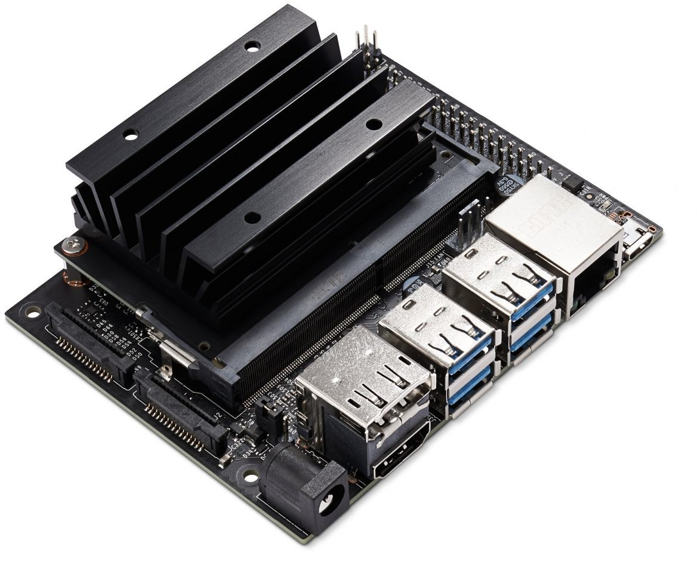
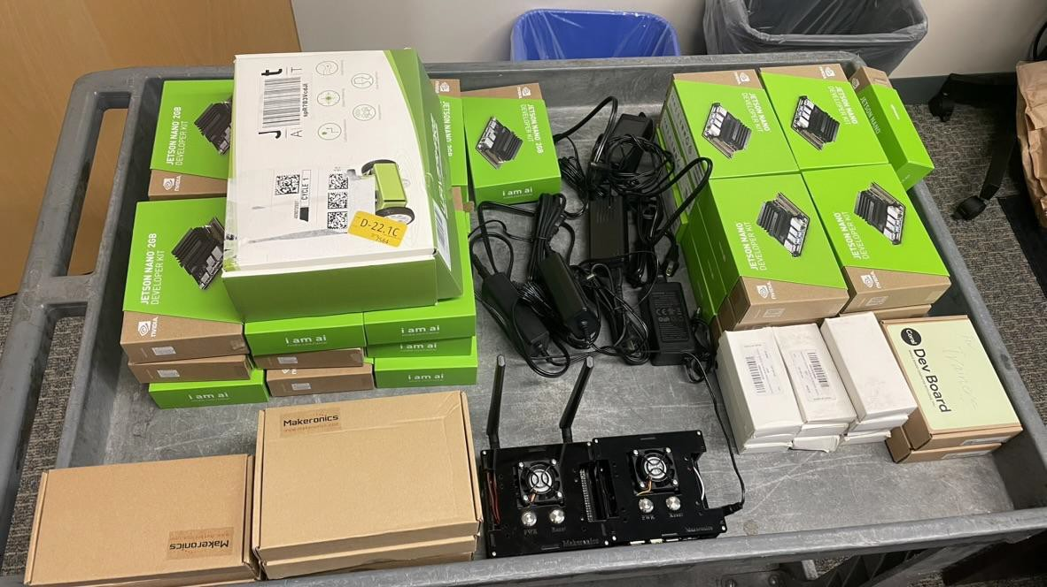
Logistics
Lectures:
[LECTURE TIMES]
Labs:
[LAB TIMES]
Final Project:
Check out devices at the Makerspace
Join Slack from Canvas
Share Q&A in slack
Answering questions is highly encouraged
Do not send emails about technical questions, as it limits discussions. Share your knowledge.

Slide 3




Today:
WHAT IS EDGE COMPUTING?
SYLLABUS
LOGISTICS
HOMEWORK

Slide 4
What is Edge Computing?
Breakout activity
Search online to create an answer to the question “What is Edge Computing?”
Put your name and answer in Quiz 0: What is Edge Computing
Bad example: John Smith - Edge computing is computing on the edge
An opportunity to find your teammates for projects
An updated version of roster

Slide 5
What is Edge Computing?
Is a buzzword ● IoT’s coolest cousin
Money making scheme ● ML in real world
Verizon’s newest product ● Self-driving cars
Cool stuff you can do ● Smartphones with 5G
A computing paradigm
Low latency computation
In-situ processing

Slide 6
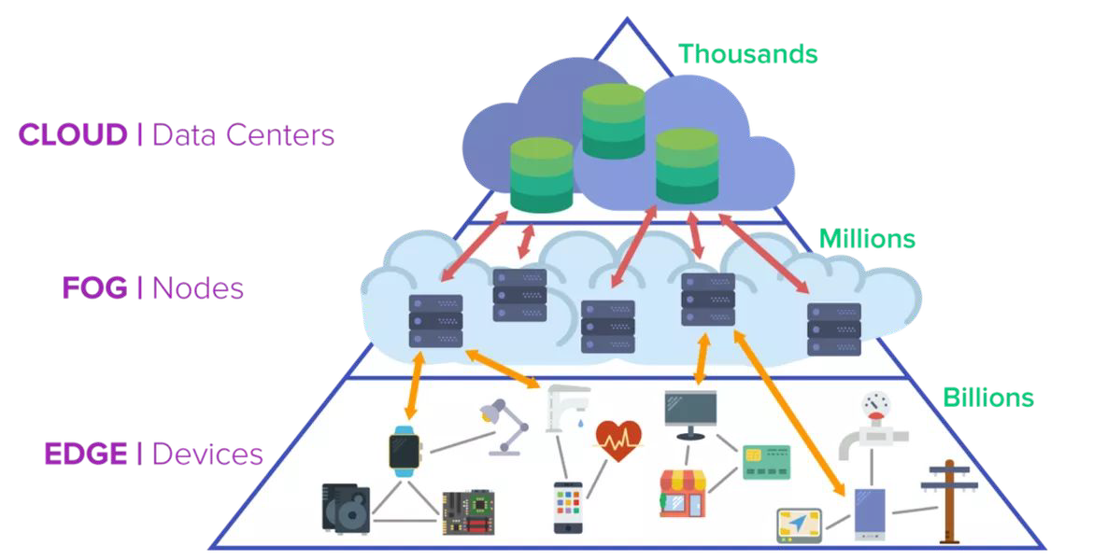
Src: https://www.imagimob.com/blog/edge-computing-needs-edge-ai

Slide 7

0
0
Networtingarchitecture that servesas the middle layer between Edge and Cloud computing
Fog Computing
Named Fog for beinga "lower
Cloud"

Slide 8
Topics
Edge computing and its applications
Edge systems: architecture, design, and optimization
Edge ML: machine learning on the edge
Edge devices: hardware acceleration
Edge & Cloud: Middleware
Edge ML Research: systems and applications

Slide 9
Course Objectives
After taking this course, you should be able to:
Describe the structure and components of an Edge Network
Make decisions on workload distribution and system tradeoffs between Edge devices and Cloud resources
Understand and identify the priorities of Edge Computing in different scenarios and use cases
Analyze and profile different architectures that will aid on processing the data
Draw cost-benefit analysis where resources are limited
Design an Edge ML application from scratch
e.g. AR/VR, health care, self-driving cars

Slide 10
Course Objectives
In addition, you get trained with
Methodologies to do independent research
Programming skills
System design skills

Slide 11
Course Structure
Quiz (10%)
Labs (20%)
Programming Exams (10%)
Paper Presentation (20%)
Final Project (40%)

Slide 12
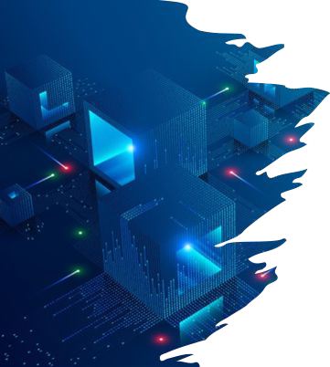
Lecture & Theory
Edge computing paradigm
Performance challenges
System optimization
ML on the edge
Hardware architectures
Ethics & Security
Edge ML research frontier (researcher position at CISL)

Slide 13
Paper Presentation (20%)
Find a top-tier conference paper/project on Edge Computing / Edge ML
Examples: https://github.com/gigwegbe/tinyml-papers-and-projects (some are dated)
Preferably relevant to your final project
Treat as related work search (avoiding reinventing the wheel)
E.g. object detection, car, pedestrian, cyclist detection has been done
E.g. health monitoring, heart rate, sleep quality monitoring has been done
Topic is unlimited
Systems and infrastructure, AR/VR, health care, transportation, agriculture, smart grid, etc.
Make presentation slides
Summarize the problem, challenges, and contributions of the paper
Dive into design details and evaluations
Make a Quiz for the audience
5x multiple choice questions focusing on presentation details
Present the slides in class (Week 6-7)

Slide 14
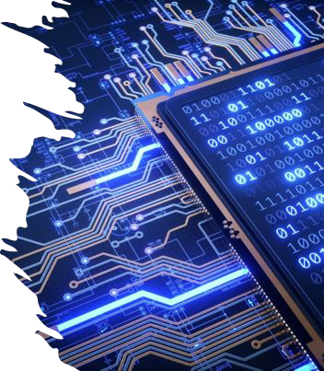
Lab & Practice
Setting up your edge devices (Nvidia Jetson Nano)
Measuring performance
Using docker with Nano
Hardware & software acceleration
Setting up a communication network
Accessing cloud computing
Running Edge ML (e.g. face detection)
Innovate novel applications

Slide 15
Final Project (40%)
Design your favorite Edge ML application
Example app domains:
Health care, transportation, AR/VR, security, systems and infrastructure, agriculture, smart farms, energy, manufacturing…
E.g. self-driving cars, sleep monitoring, mask detection, rain/cloud/solar power forecast, gait estimation, etc.
Deadline | Milestone | Description | %
Week 4 | Proposal | Idea, motivation, methodology, plan | 10
Week 7 | Deployment | Progress, resource, obstacles, remaining tasks | 15
Week 9-10 | Presentation | Demo, technical presentation | 10
Week 10 | Report | Final summary of the entire project | 5

Slide 16
Grace Day
Each team has three (3) grace days
Applied to labs only
Not Applicable to Final Project or Presentation
Start early!

Slide 17
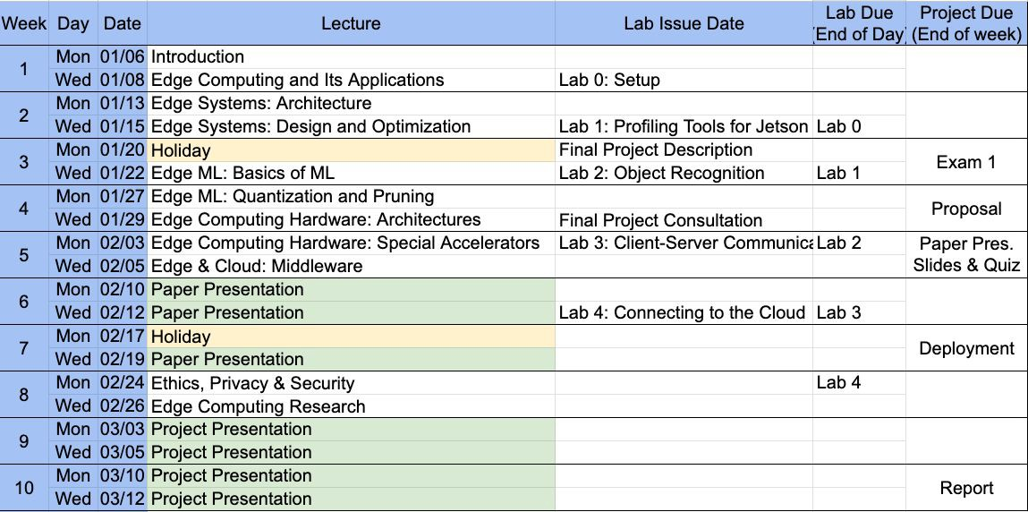
Sample Quarter Schedule

Slide 18
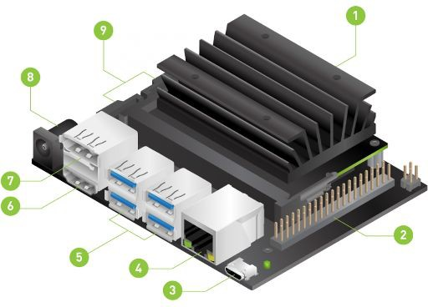
Materials
NVIDIA Jetson Nano Developer Kit
MicroSD card w/ 32GB minimum
Ethernet cable
USB keyboard and mouse
Any monitor with HDMI port
Micro-USB power supply
or alternatively…
5v 4A AC power supply
Jump-pin switch
Micro-USB to USB
Your own laptop

Slide 19
Books (not required)
The following are textbooks used as reference for this class. While useful, they are not required. All of them are free on UCR library
Situnayake, D., & Plunkett, J. (2023). AI at the Edge. O'Reilly
Buyya, R., & Srirama, S. N. (Eds.). (2019). Fog and edge computing: principles and paradigms. John Wiley & Sons.
Al-Turjman, F. (2019). Edge computing: From Hype to Reality. Springer

Slide 20
Academic Integrity
Cite your sources
Never copy and paste or paraphrase from any source without properly citing
Discussion is encouraged but make sure to implement on your own
Code plagiarism will be checked, and will be given a 0 for the project/lab/exam
Partial points will be given for honest efforts

Slide 21
Team up
By default, labs and final projects are done in a team of two (2) members
Exception can be granted for 3 members if the final project scope is large
Apply for exception before Lab 0
Sign up sheet: EE/CS131: Team sign-up
Deadline: Tuesday before Lab
TA will issue Jetson Nanos for registered team members

